Slide 1
Unit 4
SSD

Slide 2
SSD
Short for solid-state drive, an SSD is a storage medium that uses non-volatile memory to hold and access data.
Unlike a hard drive, an SSD has no moving parts, which gives it advantages, such as faster access time, noiseless operation, higher reliability, and lower power consumption.

Slide 3
There are no moving mechanical components in SSD.
This makes them different from conventional electromechanical drives such as hard disk drives (HDDs) or floppy disks, which contain movable read/write heads and spinning disks.

Slide 4
SSDs are typically more resistant to physical shock, run silently, have quicker access time compared to electromechanical devices.
The price of SSDs has continued to decline over time but SSDs are in 2018 are still more expensive per unit of storage than HDDs and are expected to continue to be so into the next decade.

Slide 5
Similarities between HDD and SDD:
Both are used to store data.
Both are used to boot the system.

Slide 6
Differences between HDD and SDD :
Parameter | HDD | SSD
Full Form | HDD stands for Hard Disk Drive. | SSD stands for Solid State Drive.
Components | HDD contains moving mechanical parts, like the arm. | SSD does not contains, mechanical parts, only electronical parts like ICs.
R/W Time | HDD has longer R/W time. | SSD has shorter R/W time..
Latency | HDD has higher latency. | SSD has lower latency.
I/O operations per second | HDD supports fewer I/O operations per second. | SSD supports more I/O operations per second.
Fragmentation | HDD has fragmentation. | SSD do not has fragmentation.
Weight | HDD is heavier in weight. | SSD is lighter in weight.
Size | HDD is larger in size. | SSD is more compact in size.
Data Transfer | In HDD the data transfer is sequential. | In SSD the data transfer is random access.
Reliability | HDD is less reliable due to possibility of mechanical failure, like head crash and susceptibility to strong magnets. | SSD is more reliable.
Cost | HDD is cheaper per unit storage. | SSD is costlier per unit storage.
Time of Release | HDD is older and more traditional. | SSD is newer to use.
Noise | HDD can produce noise due to mechanical movements. | SSD does not produces noise.
Parameter | HDD | SSD
Full Form | HDD stands for Hard Disk Drive. | SSD stands for Solid State Drive.
Components | HDD contains moving mechanical parts, like the arm. | SSD does not contains, mechanical parts, only electronical parts like ICs.
R/W Time | HDD has longer R/W time. | SSD has shorter R/W time..
Latency | HDD has higher latency. | SSD has lower latency.
I/O operations per second | HDD supports fewer I/O operations per second. | SSD supports more I/O operations per second.
Fragmentation | HDD has fragmentation. | SSD do not has fragmentation.
Weight | HDD is heavier in weight. | SSD is lighter in weight.
Size | HDD is larger in size. | SSD is more compact in size.
Data Transfer | In HDD the data transfer is sequential. | In SSD the data transfer is random access.
Reliability | HDD is less reliable due to possibility of mechanical failure, like head crash and susceptibility to strong magnets. | SSD is more reliable.
Cost | HDD is cheaper per unit storage. | SSD is costlier per unit storage.
Time of Release | HDD is older and more traditional. | SSD is newer to use.
Noise | HDD can produce noise due to mechanical movements. | SSD does not produces noise.

Slide 7
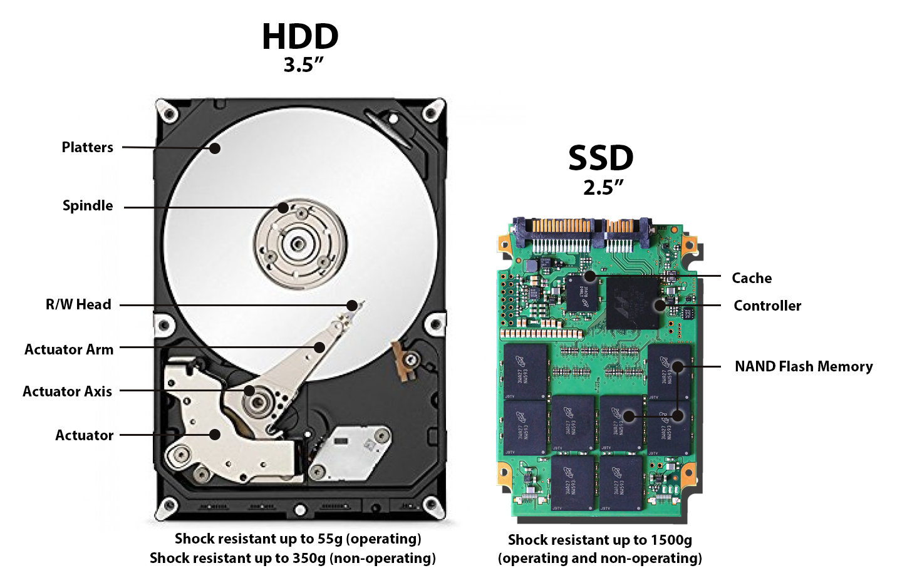

Slide 8
